Slide 1
Trading off precision and recall
Thang Nguyen

Slide 2
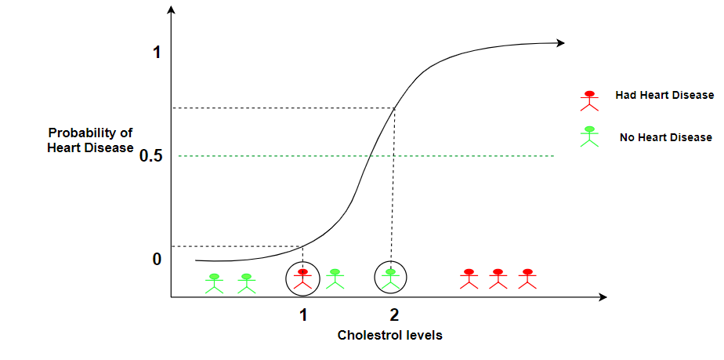


Precision and recall
Logistic regression:
Predict 1 if
Predict 0 if
Threshold

Slide 3
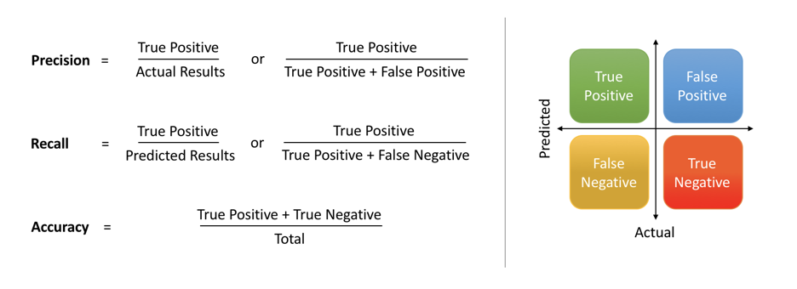
Precision and Recall

Slide 4
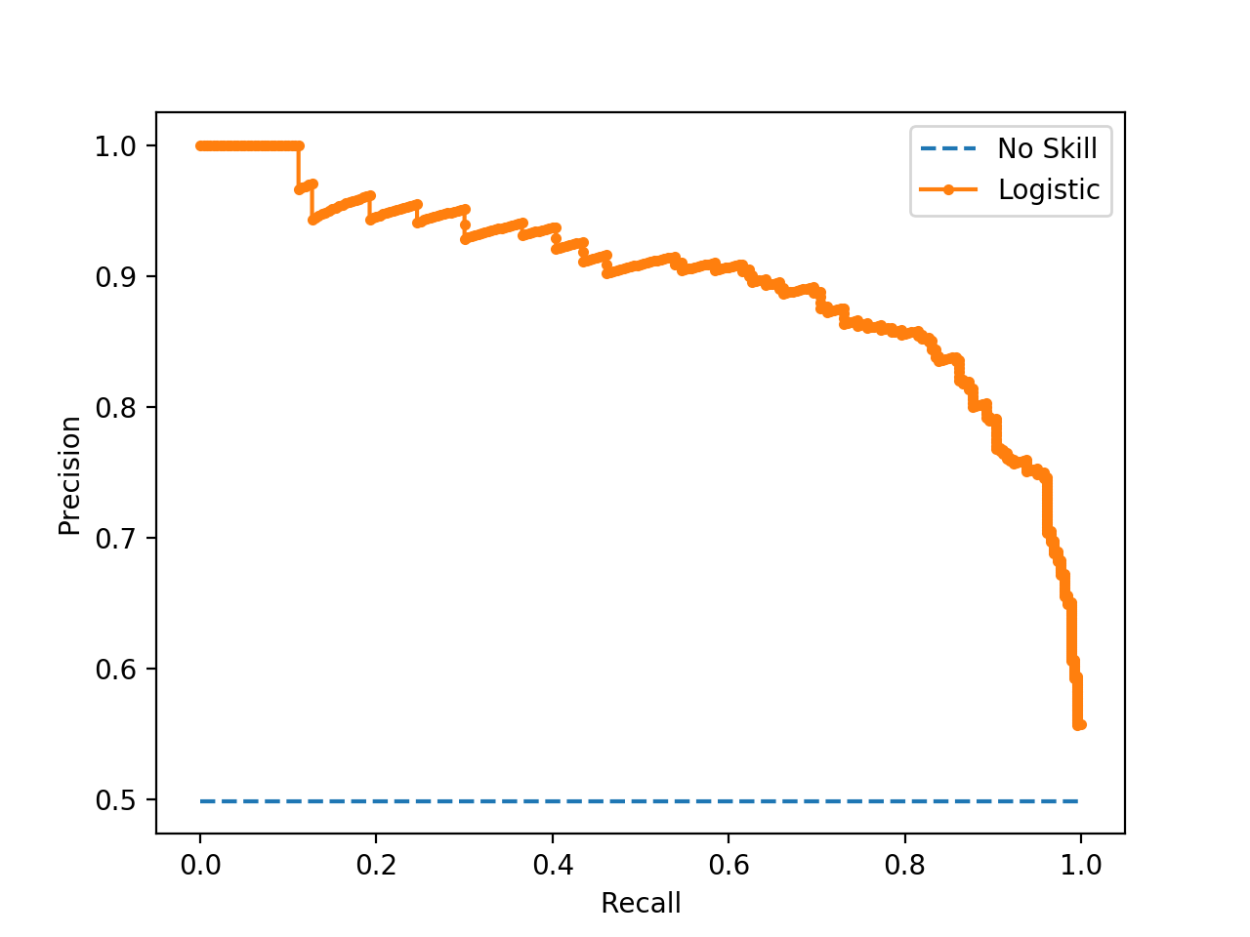
Precision and Recall

Slide 5
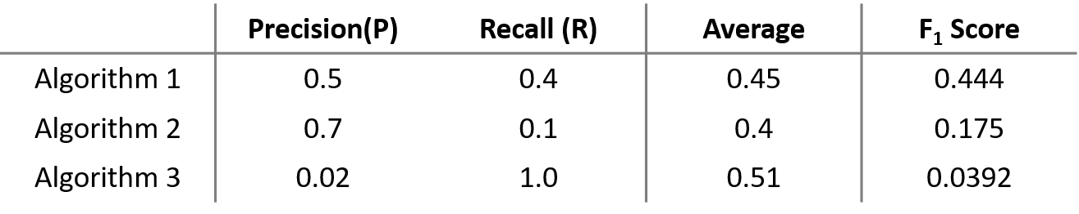
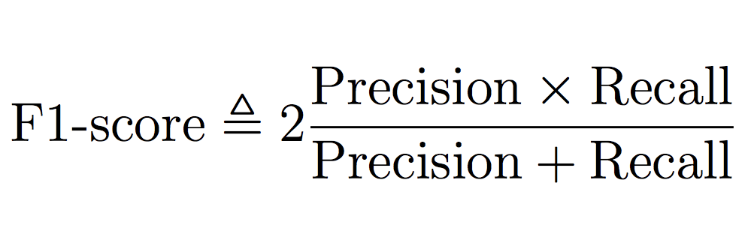
F1 score
Example
F1 score = harmonic mean of Precision and Recall

